Slide 1
Don’t just Code it—Generate it!
Kevin J Mackey

Slide 2
About
History/Why
Code Generator Anatomy
Final Thoughts
Kevin J Mackey
kevin@mackey.name
http://kjmackey.wordpress.com
@kevinjmackey

Slide 3
About
What Data View offers (the other sales pitch)
  SQL Saturday Sponsor!!
  Service Broker (obviously)
  Data Profiling and Analysis
  ETL and Business Intelligence Solutions
  ETL Conversions (Informatica to SSIS)
  Mainframe Analytics

Slide 4
You know what they say:
Use metadata to make your code do what you want.

Slide 5
I say:
Use metadata to make your code.

Slide 6

I say:
Use metadata to make your code.
Do what you want.

Slide 7
History/Why

Slide 8
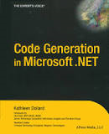
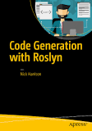
History/Why
Back in the day: COBOL Generator
Back in 2004 (Kathleen Dollard)
Up to 2017 (Nick Harrison)

Slide 9
Says who?
Rocky Lhokta: “You know you need a code generator when your coding process can be described as an algorithm.”
Alan Cameron Wills et al: "To obtain the full benefit of code generation, try to generate program code instead of configuration files."
Remus Rusanu: "...I think you should use some sort of template/code generation when creating SSB activated process…”
Nick Harrison: “...get the best of both worlds by using table-driven business logic to drive the generation of compiled code…”

Slide 10
Why?
We’re already doing it:
  “Old code lying around”
  Stack Overflow
  MSDN Doc Pages

Slide 11
Why?
Sometimes there’s just too much to do
    Service Broker messages:
      Queues
      Services
      Routes
      Stored Procedures

Slide 12
How?
We’re already doing it:
  Global Search & Replace
  Fix the results of the above…
  Extend samples we found
  Code Snippets/Templates

Slide 13
How?
We’re already doing it:
  Global Search & Replace
  Fix the results of the above…
  Extend samples we found
  Code Snippets/Templates
Maybe: write a String.Replace() function that gets rid of some of the drudgery

Slide 14
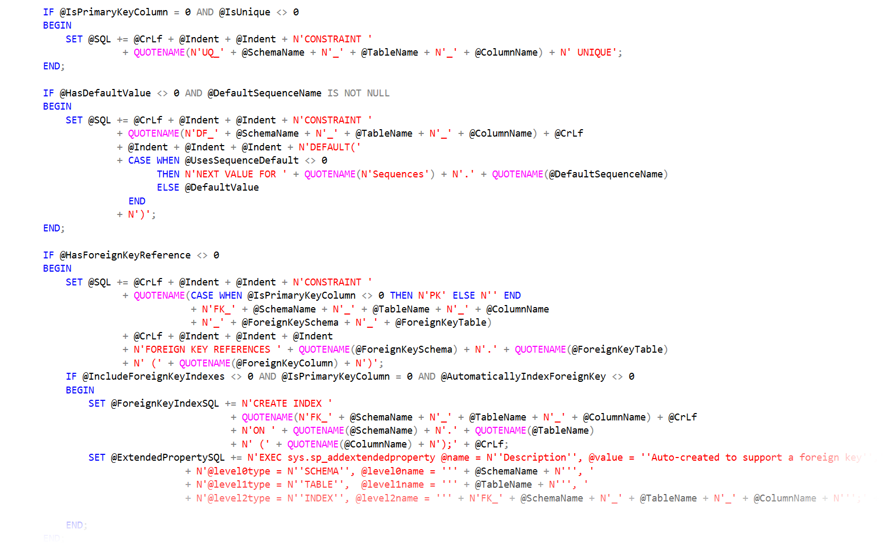
How? Dynamic SQL

Slide 15

How? Dynamic SQL
then somewhere at the end…

Slide 16
Code Generator Anatomy

Slide 17
Code Generator Anatomy
Metadata
matched with…
Some Template(s)
by a…
A Driver program

Slide 18
Metadata
Three types:
  Natural
  Hybrid
  Custom

Slide 19
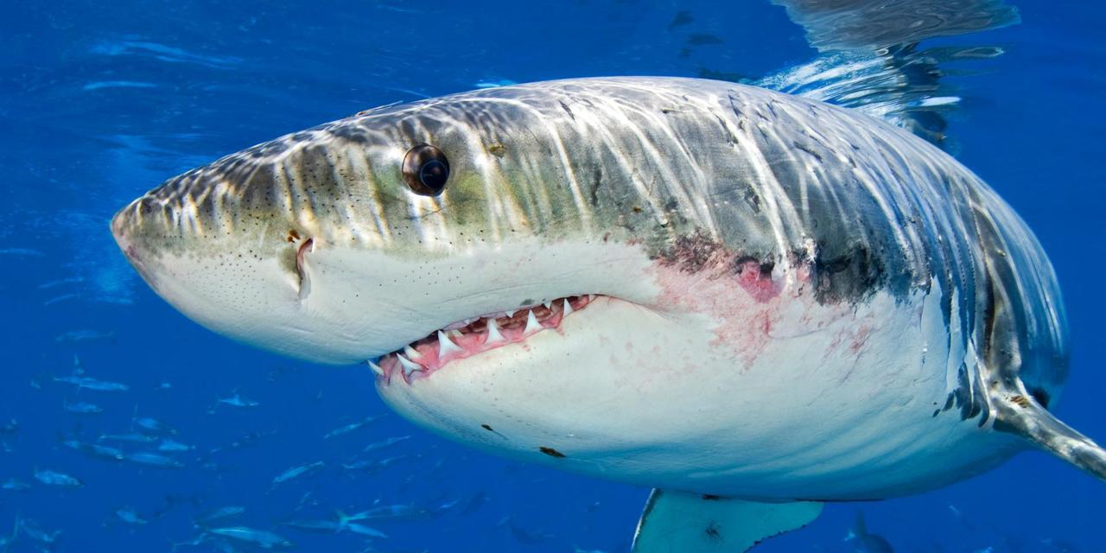
Metadata—Natural
INFORMATION_SCHEMA (or sys.objects)
  Schema
  Tables
  Columns

Slide 20
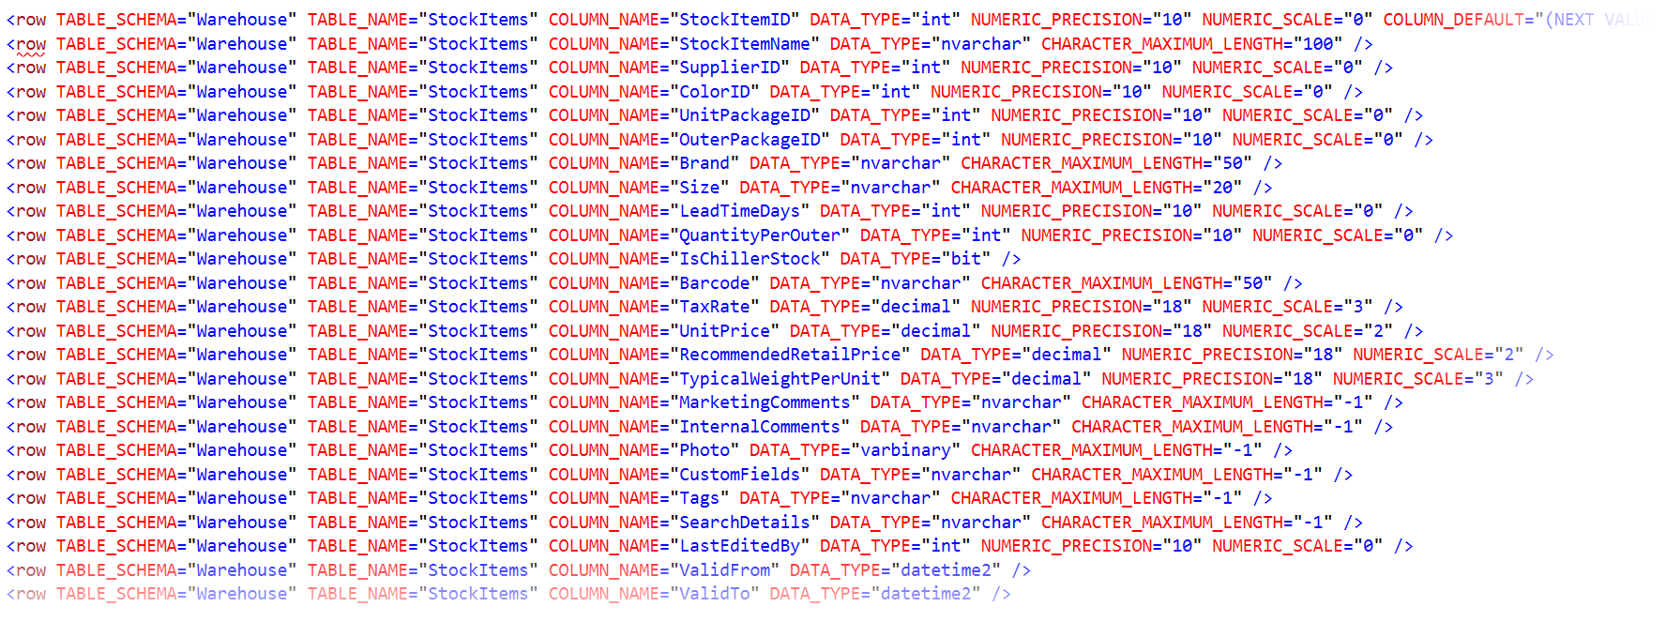
Metadata—Natural

Slide 21
Code Generator Anatomy
Metadata—Natural (in XML)
matched with…
An XSLT Template
by a…
A C# program

Slide 22
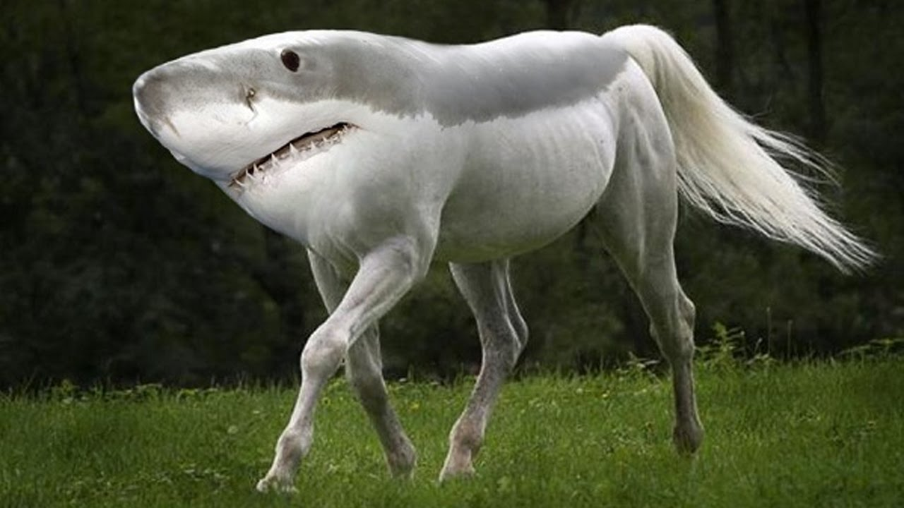
Metadata—Hybrid
INFORMATION_SCHEMA (or sys.objects)
plus…
  Parent/Child tables
  Entity grouping
  Operation ordering

Slide 23
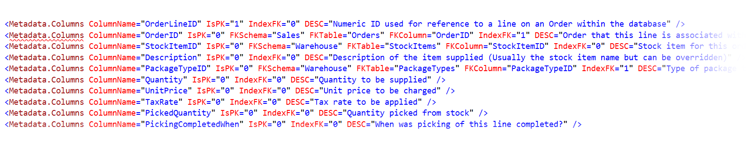
Metadata—Hybrid

Slide 24

Metadata—Custom
Business Rules (anything goes)
  Computed Columns
  Dimension/Fact tables (and types)
  Source/Target Mapping
  Metadata Versions

Slide 25
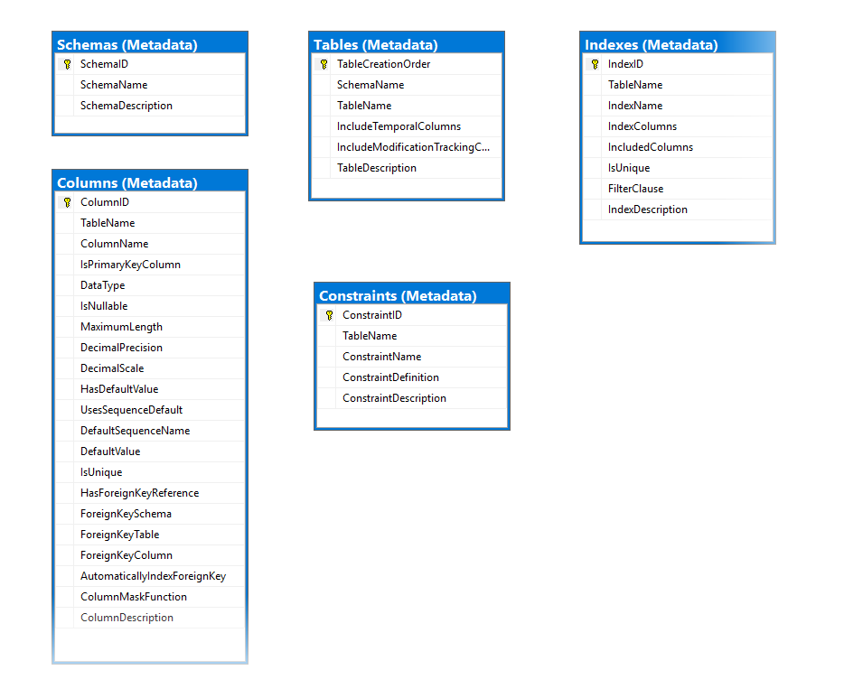
Metadata—Custom

Slide 26
Code Generator Anatomy
Metadata
matched with…
Some Template(s)
by a…
A Driver program

Slide 27
Template(s)
Dealer’s Choice:
  XSLT
  Text Template Transformation Toolkit (T4)
  StringTemplate (Java engine—from the ANTLR guy)
  Python libraries
  Microsoft’s Roslyn compiler

Slide 28
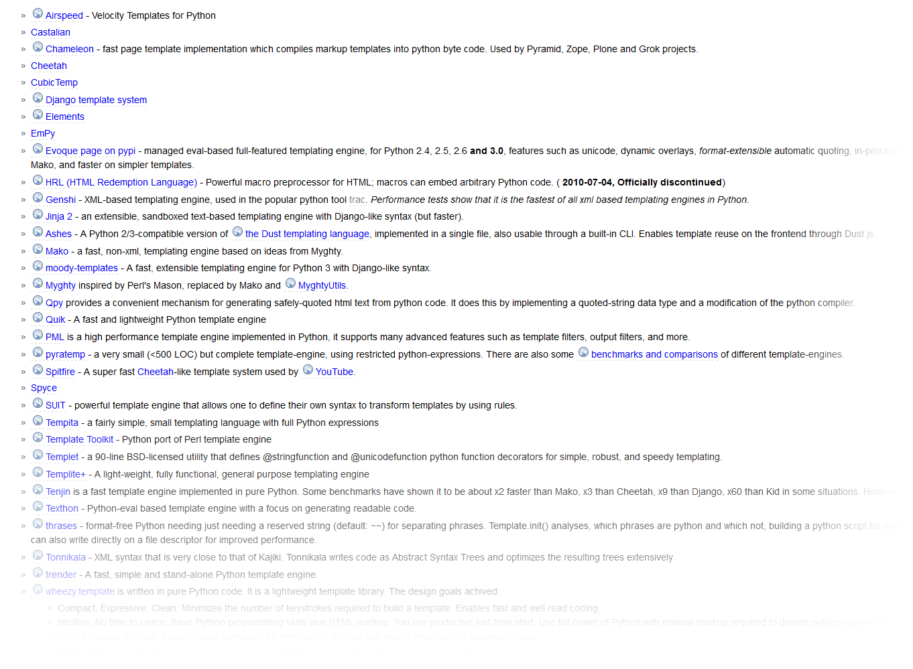
Template(s)—Python

Slide 29
Template(s)
What to look for:
  Looping structures
  Conditional expressions
  Macro capability (code reuse)
  Include file capability (code reuse)
  Simplicity

Slide 30
Template(s)
Examples of pyratemp templates
  CRUD Stored Procedures
  XPath Parsing
  C# code generation (why not?)

Slide 31
Template(s)
Template approaches
  Make decisions in the template—not in the generated code
  Don’t use this kind of syntax: Object_Name(@@PROCID) Generate the hardcoded value
  Use macros/includes where you can (code reuse)
  You know you have your metadata right if you can use it for more than one template

Slide 32
Code Generator Anatomy
Metadata
matched with…
Some Template(s)
by a…
A Driver program

Slide 33
A Driver Program
Anatomy of a driver program:
  Command Line parser (what to do?)
  Acquire metadata in a form useful to the template(s)
  Merge the template(s) and metadata

Slide 34
A Driver Program
Anatomy of a driver program (using Python)
  argparse
  pypyodbc
  pyratemp

Slide 35
A Driver Program
Anatomy of a driver program (using Python)
  argparse
  pypyodbc
  pyratemp
Let’s take a look

Slide 36
Final Thoughts
Metadata
  All you need/As little as you can get away with
  You’re not creating a product/writing a book
Templates
  Choose what works/Can be maintained
  Re-use metadata & drivers for multiple templates

Slide 37
And finally…
???

